Slide 1
Natural Language Processing Textual Data Handling - NLTK

Slide 2
Course outline
Discuss textual data and their characteristics - NLTK
Use Python modules to clean textual data
Use Python modules to parse and clean HTML documents
Use Python modules to remove punctuation and stopwords
Use Python modules for textual data tokenization
Discuss the process of text mining and stemming
Discuss and use Python modules to encode textual data as bag of words
Discuss the concept of TF/IDF scoring in Python

Slide 3

Contents
Textual Data
Cleaning Textual Data
Parsing and cleaning HTML data
Word Tokenization
Removal of Stop Words
Stemming
Bag of Words
TF/IDF

Slide 4
Textual Data
Generally we work on many textual datasets which are either in csv or excel format with data split into attributes and fields in proper format. This is called Structured Textual data. While coming to Natural Language processing the textual data which we are talking about is unformatted data called unstructured data.
Data which we process using NLP applications generally contains words, text sentences, clauses, phrases and paragraphs. This data doesn’t have any proper structure to be parsed unlike structured data. Hence data cleaning, processing etc. are required to perform. Perfect example of the kind of textual data which we handle in NLP would be this slide, the content in this slide.

Slide 5
Problem with Text
The ultimate goal in any Natural Language Processing application is building a model on the textual data according to the business case and then use the model.
Machine Learning algorithms or any neural network algorithms generally work on numbers or vectors which are numeric representations.
Textual data needs preprocessing as its mostly unstructured and has much noise, hence data cleaning plays a major role in any NLP application.
Textual data is messy, as it has words and application of any machine learning algorithm on textual data directly is not possible. Hence the text must be converted into numbers, especially into vectors of numbers. This is called as Feature Extraction or Feature Encoding.

Slide 6
Cleaning Textual data
Removal of Stop Words:
Stop words are the words which are used most by humans and add less significance to the business use case in hand. Some examples of stop words are might, may, let, must, need, basically, yeah etc.
Stop words are removed as they are less significant and can be considered a preprocessing step. Either the stop words can be removed explicitly, or another vector space can be created to store the instances of stop words for more accurate business use cases.
Tokenization:
Tokens can be words, clauses, phrases or sentences which are part of an actual sentence
Textual data is divided into classified set of tokens which cause significant advantage to business use case.

Slide 7
Cleaning Textual data
Expanding Contractions:
Contractions are words such as I’ve, didn’t, we’ve, shouldn’t etc. These contractions are expanded into actual words as I have, did not, we have, should not correspondingly.
Stemming:
Stemming is a text pre-processing technique which reduces a word to its stem or root format.
Stemming algorithms are very simple and similar to search and replace operation.
Lemmatization:
It is a text pre-processing technique similar to stemming which reduces a word to its root format.
Lemmatization uses branching techniques and dictionary to map different variants of words to a base word called lemma.

Slide 8
Parsing HTML Documents
There are many tools for web scraping and obtaining HTML data for webpages in HTML format. Python provides libraries such as urllib and scrapyd for web scraping.
Once we have HTML data, the next task is to parse the HTML data as textual data.
As we know HTML pages contain data in form of tags. Hence we have to parse data from HTML format to extract textual data by removing tags and other HTML components.
Python provides libraries such as bolierpy3 and BeautifulSoap to parse textual data from HTML pages. By using these libraries for parsing we get textual data from HTML pages .

Slide 9
Cleaning HTML Documents
Cleaning HTML documents is similar to cleaning any other text documents as the data in HTML documents is now parsed as textual data.
But generally HTML documents contain repeated data, this might be because the data which we are extracting might consider different web pages and hyperlinks etc.
Large N-gram cleaning is a Natural Language processing Technique which generates N-grams on our data and checks for them in the data. If repetitive N-grams are found in data then they are eliminated.
If N = 1 then they are called Unigrams. Example : ‘a’, ‘as’ etc. But we are not considering small N-grams as sentences might have some small set of words repeated.

Slide 10
Cleaning HTML Documents
Let’s take an example to generate Tri-grams (N=3).
Sentence = ‘It is raining heavily outside’
Trigrams = [‘It is raining’ , ‘is raining heavily’ , ‘raining heavily outside’]
By searching for large n-grams that occur frequently, we are able to detect the repeated elements across websites in our corpus, and manually filter them out.
Python nltk provides inbuilt functions for ngrams in util module.
From nltk.util import ngrams
After mapping the data with the list of N-grams generated we store the document frequencies for each n-gram and eliminate the repeating phrase from the document if the frequency of n-grams is greater than 1 or 2.

Slide 11
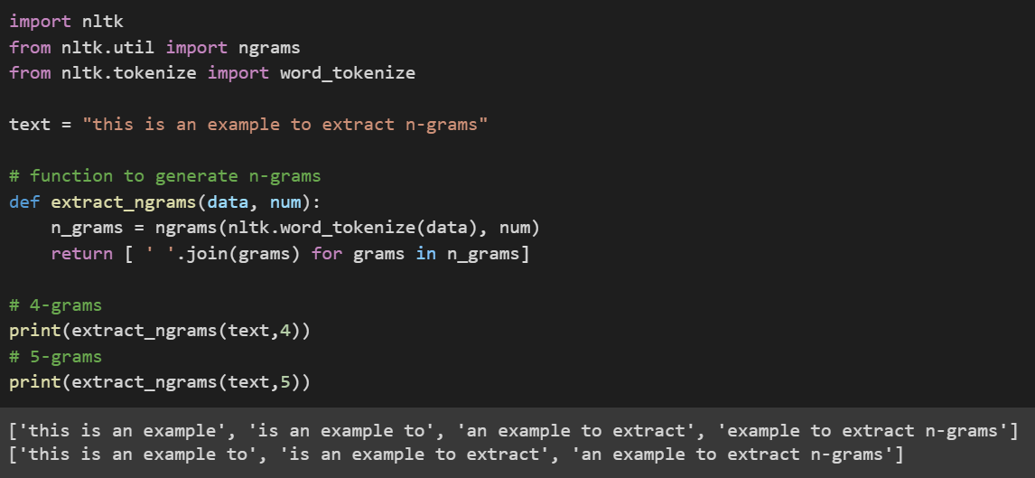
Cleaning HTML Documents

Slide 12
Word Tokenization
Tokens can be words, clauses, phrases or sentences which are part of an actual sentence. Textual data is divided into classified set of tokens which cause significant advantage to business use case.
Word Tokenization can be achieved using various kinds of Word tokenizers in Python
TreeBankWordTokenizer
PunktWordTokenizer
WordPunctTokenizer
RegExpTokenizer

Slide 13
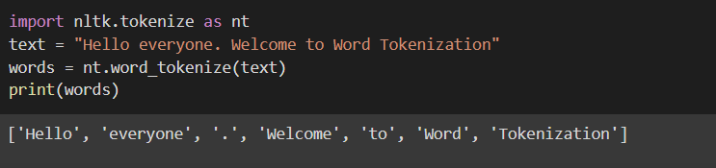
Word Tokenization
word_tokenize() function in nltk.tokenize module can be used to split text into words. Word_tokenize function uses an instance of tokenize() from TreebankWordTokenizer class.

Slide 14
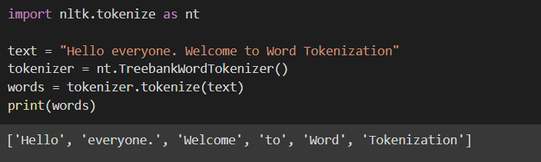
Word Tokenization
Using tokenize() method from TreebankWordTokenizer class in nltk.tokenize module
This tokenizer works by tokenizing words by spaces and punctuations, so we won’t get a separate token for any punctuation marks. This gives us advantage to handle the punctuations stored along with word as a token at the time of pre-processing.

Slide 15
Word Tokenization
Like TreebankWordTokenizer class we can also use the following classes in nltk.tokenize module.
PunktWordTokenizer - it doesn’t separate punctuation from words
WordPunctTokenizer - separates punctuation and stores it as a separate token
RegexpTokenizer – Tokenizes words using Regular expression Patterns
from nltk.tokenize import PunktWordTokenizer
from nltk.tokenize import WordPunctTokenizer
from nltk.tokenize import RegexpTokenizer

Slide 16
Stop Words
Stop words are the words which are used most by humans and add less significance to the business use case in hand. Some examples of stop words are might, may, let, must, need, basically, yeah etc.
Stop words are removed as they are less significant and can be considered a preprocessing step. Either the stop words can be removed explicitly, or another vector space can be created to store the instances of stop words for more accurate business use cases.

Slide 17
Removal of Stop Words
By looking at the word removal of stop words, the basic thought which we would get on how to remove stop words is by storing them in a list and removing all the occurrences of those words from text.
nltk module in python stores all the stop words in different languages.
We can simply import them as from nltk.corpus import stopwords
To remove stop words, first the text must be split into tokens and these tokens are then looped over the set of stop words to remove them.

Slide 18

Removal of Stop Words
Let’s have a look at available stop words in nltk.corpus
'just', 'here', 'than', 're', 'yours', 'hers', 'them', 'is', 'needn', 'doing', 'mustn', 'he', 'between', 'with', 'after', 'isn', 'who', 'again', 'once', 'most', 'll', 'couldn', 'no', "won't", 'won', "should've", 'before', 'very', 'nor', "weren't", 'd', "you'd", 'were', 'under', 'a', 'while', 'was', 'over', 'been', "needn't", 'are', 'those', 'yourself', 'i', 'you', 'what', 'am', 'only', 'if', 'be', 'aren', 'down', 'where', 'from', 'we', 'into', 'there', 'mightn', 'for', 'your', 'yourselves', 'then', 'me', 'which', 'an', 'not', "couldn't", 'in', 'do', 'itself', 'on', 'had', "she's", 'how', 'same', 'can', 'by', 'herself', "aren't", 'some', 'all', 't', 'y', 'my', 'themselves', "didn't", 'doesn', 'will', 'hadn', "mustn't", 'shouldn', 'so', 'out', 'about', 'that', 'of', "hadn't", "mightn't", 've', 'her', "shan't", 'didn', 'but', "hasn't", 'haven', 'did', 'ourselves', 's', 'own', "you're", 'until', "shouldn't", 'wasn', 'm', 'further', 'too', 'these', 'weren', "haven't", "wasn't", 'our', 'their', 'hasn', "it's", 'other', 'should', 'being', 'his', 'himself', 'because', 'against', 'above', 'both', "wouldn't", 'wouldn', 'o', 'does', 'its', 'they', 'ours', 'have', "don't", 'ma', 'such', 'as', 'this', 'at', 'theirs', "you'll", 'she', 'has', 'up', 'shan', 'more', 'any', "isn't", 'during', 'below', 'whom', 'and', 'why', 'having', 'him', "that'll", 'now', 'myself', 'few', 'it', 'through', 'off', 'the', "you've", 'ain', "doesn't", 'or', 'when', 'to', 'don', 'each'

Slide 19
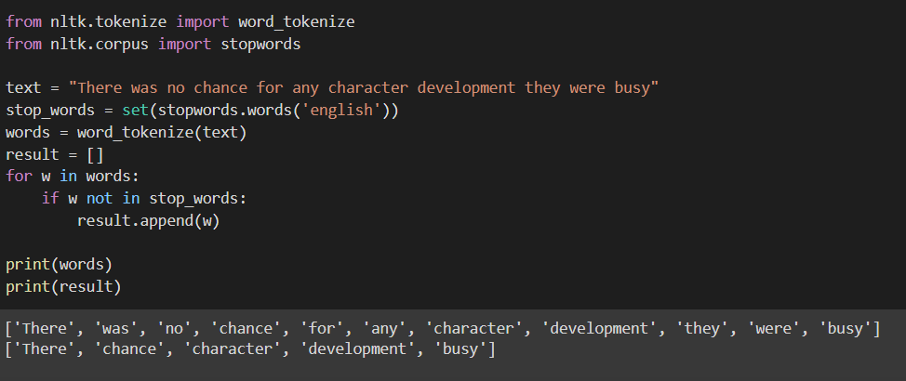
Removal of Stop Words
Load the set of stop words in English from nltk.corpus module
Tokenize the text into words
Loop the word tokens over the set of stop words to remove them from word tokens.

Slide 20
Stemming
Stemming is a text pre-processing technique which reduces a word to its stem or root format.
Stemming is done by maintaining a set of rules to the words and map them on to data.
Stemming algorithms are very simple and like search and replace operation.
Example : all the words ending with ‘ing’ and ‘ed’ suffixes can be dropped. This reduces the word mostly to their stem/root word, but in some cases it won’t.
Words that are derived from another word as their use in the speech changes are called Inflected words.
Various algorithms for stemming follow approaches such as
Listing all the inflected forms and looking up for best match in the stem words listing
Recognizing known prefix or suffix on known inflected forms and removing them to get the stem word.

Slide 21
Stemming
In Python stemming can be done using python nltk module (natural language tool kit)
There are two stemmers (stemming algorithms) available in nltk.
PorterStemmer
LancasterStemmer
Porter stemmer is older algorithm when compared with Lancaster and Lancaster stemmer is more aggressive compared to it.
Porter Stemmer uses suffix stripping and doesn’t follow linguistic rules, rather follows a set of 5 rules (steps) designed for various cases (step by step).

Slide 22
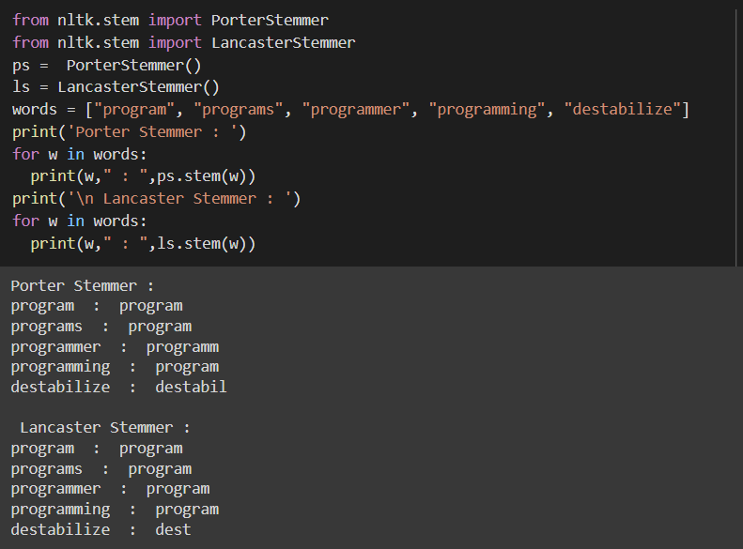
Stemming
Porter Stemmer is known for its simplicity and speed
Lancaster stemmer stores rules externally and follows an iterative algorithm making it a heavy and iterative stemmer. Hence there is possibility of over stemming.
Destabilize is over stemmed as dest in the below example

Slide 23
Feature Extraction
Feature extraction is a trivial step in the NLP workflow
It is done for a better understanding of context of what data we are dealing with.
After cleaning and normalization of data, it is transformed into features for modelling
We use feature extraction methods to assign weights to particular words within our data or text before modelling. Computers or machine learning algorithms process on numbers.
Hence, we go for numerical representations of words in data or vectorization of data.

Slide 24
Feature Extraction
Storing the counts of words etc. methods can be applied, and text can be converted into numbers or vectors of numbers for machine learning model.
The basic requirements for vectorizing the sentence could be
It should not result in a sparse matrix since sparse matrices result in high computation cost
We should be able to retain most of the linguistic information present in the sentence
There are many such techniques for vectorizing the text into numbers
Bag of Words model
TF-IDF
One hot encoding

Slide 25
Bag of Words
Bag of words is a simple and most used model for extracting features from text and using them in building models.
Bag of words approach is simple and flexible and easy for any one to use
It is a technique which extracts features as representation of text based on the occurrences of words within the text.
This method involves two major things:
Vocabulary of known words
Measure of the presence of known words

Slide 26
Bag of Words
Bag of words model basically consists of 3 major steps
Collect data
Design the Vocabulary
Create vectors
Let’s investigate each of the steps in detail by taking an example
Collect Data:
Let’s take a sample of data from movie reviews.
This movie is very scary and long
This movie is not scary and is slow
This movie is spooky and good

Slide 27
Bag of Words
Design Vocabulary:
Now we make list of all the unique words present.
We ignore the order and case of the words (all the words are converted into lower case)
The list of unique words in our use case forming vocabulary.
Vocabulary consists of words: “this”, “movie”, “is”, “very”, “scary”, “and”, “long”, “not” , “slow”, “spooky”, “good”.
Hence the vocabulary now consists of 11 unique words
These 11 unique words form the sentences in the data corpus which we are using

Slide 28
Bag of Words
Creation of vectors:
The objective of vectorization is to convert the text into vectors of numbers that we can use as input or output for any machine learning model.
We now have 11 words in the vocabulary. Hence, the length of each vector to represent each word occurrence will be 11.
The simplest way of scoring the occurrence of word in the vector is by a Boolean value. A value of 1 represents the word is present and 0 represents its absence.
Using the arbitrary order mentioned above in the vocabulary let’s make a binary vector for text

Slide 29
Bag of Words
Creation of vectors:
The scoring of all the reviews would be as follows
[ “this”, “movie”, “is”, “very”, “scary”, “and”, “long”, “not” , “slow”, “spooky”, “good” ]
Review 1 : This movie is very scary and long = [ 1 , 1 , 1 , 1 , 1 , 1 , 1 , 0 , 0 , 0 , 0 ]
Review 2 : This movie is not scary and is slow = [ 1 , 1 , 1 , 0 , 1 , 1 , 0 , 1 , 1 , 1 , 0 , 0 ]
Review 3 : This movie is spooky and good = [ 1 , 1 , 1 , 0 , 0 , 1 , 0 , 0 , 0 , 1 , 1 ]
New documents that overlap with the vocabulary of known words, but may contain words outside of the vocabulary, can still be encoded, where only the occurrence of known words are scored, and unknown words are ignored.

Slide 30
Bag of Words - NLTK
Bag of words model can be implemented in python using nltk and numpy modules
Let us take the following data and implement bag of words on it.
This movie made it into one of my top 10 most awful movies. Horrible. There wasn't a continuous minute where there wasn't a fight with one monster or another. There was no chance for any character development, they were too busy running from one sword fight to another. I had no emotional attachment ( except to the big bad machine ## that wanted to destroy them).

Slide 31
Bag of Words - NLTK
Preprocess the data:
Lower case conversion of text
Remove all non word characters
Remove all punctuations
We use nltk sentence tokenizer to prepare our data corpus
Regular expressions to remove punctuations and non word characters.
Now we have preprocessed and cleaned data. Next part is building the vocabulary

Slide 32
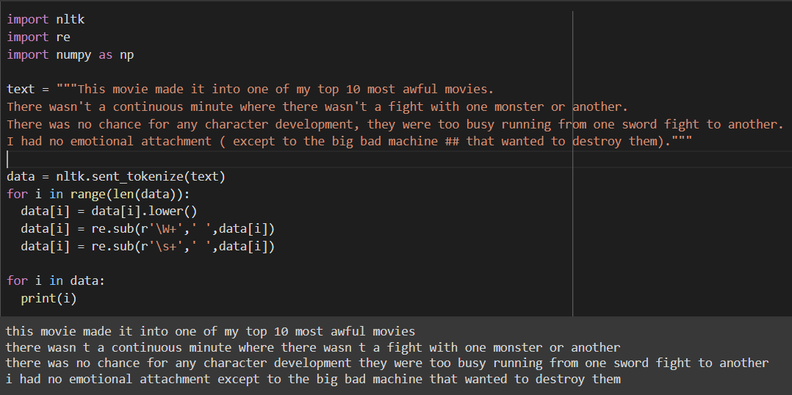
Bag of Words - NLTK

Slide 33
Bag of Words - NLTK
Creation of Vocabulary (obtaining most frequent words in our text):
Tokenize each sentence into words
For each word check if word exists in dictionary, if it exists then increment by 1
If it doesn’t exist add that word to dictionary and assign count as 1
In our model we have a total of 53 words.
However, when processing large texts, the number of words could reach millions. We do not need to use all those words. Hence, we select a particular number (30) of most frequently used words.

Slide 34
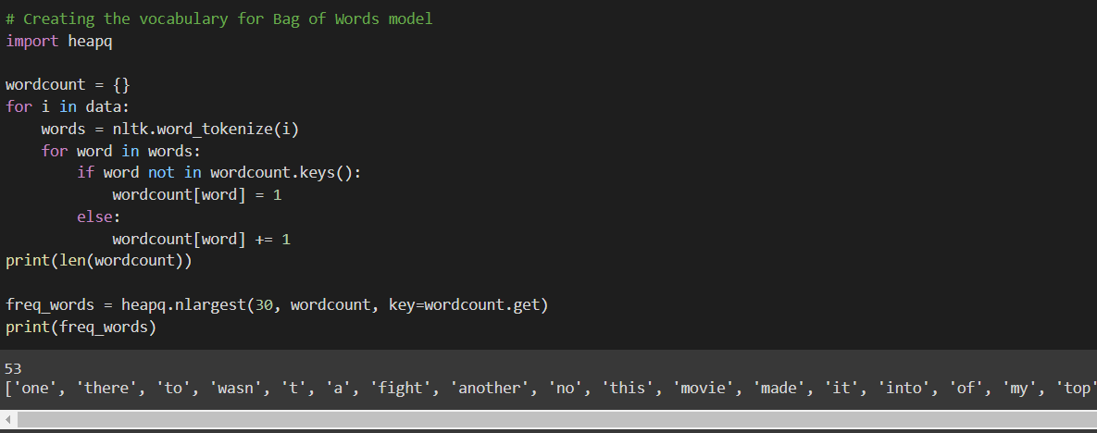
Bag of Words - NLTK

Slide 35
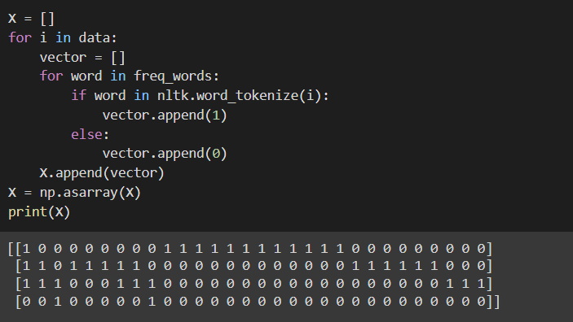
Bag of Words - NLTK
Creation of vectors:
In this step we construct a vector, which would tell us whether a word in each sentence is a frequent word or not. If a word in a sentence is a frequent word, we set it as 1, else we set it as 0.

Slide 36
TF - IDF
In Bag of words approach each word is treated equally, but in a document there is a high chance that a particular word repeats more often than others.
TF – IDF stands for Term Frequency – Inverse Document Frequency
TF - IDF works with assigning weights according to importance.
If we take each sentence as a document and counting the number of documents each time a word occurs, it is called document frequency. Term frequency is the frequency of occurrence of word. We then divide TF by IDF to get TF-IDF

Slide 37
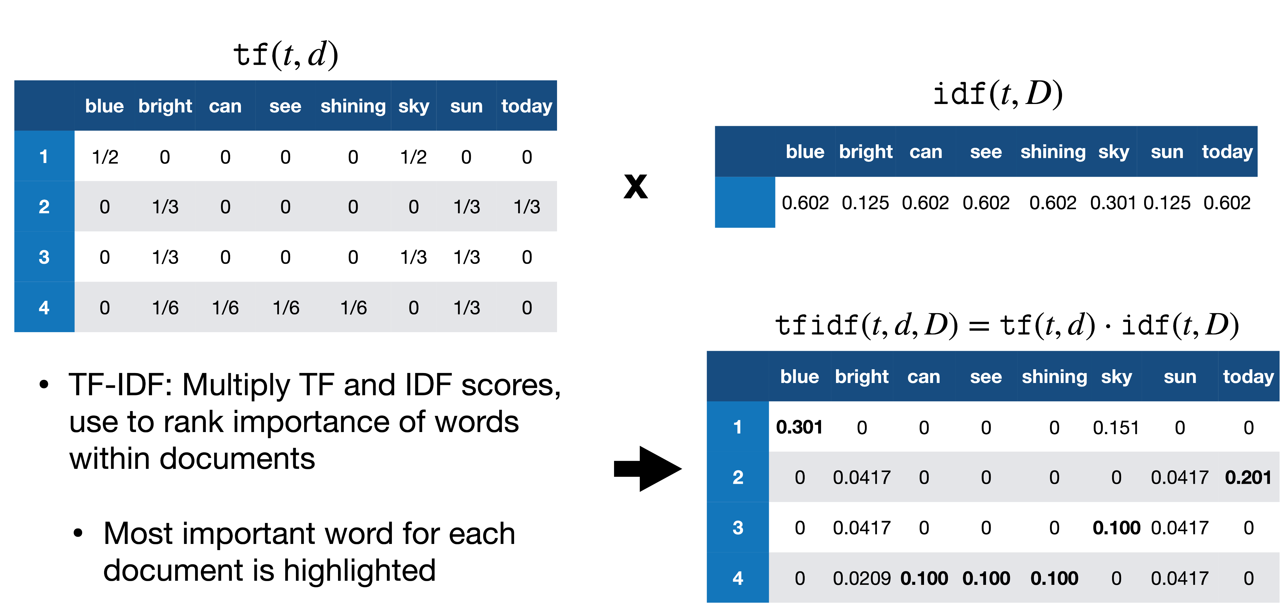
TF - IDF
Source : analyticsvidhya

Slide 38
TF - IDF
Term Frequency: is a scoring of the frequency of the word in the current document.
Inverse Document Frequency: is a scoring of how rare the word is across documents.
Term frequency can be calculated as number of occurrences of a word in a sentence divided by total number of words in a sentence
Inverse document frequency can be calculated as logarithm of number of sentences divided by number of sentences containing that words.
TF-IDF = TF * IDF

Slide 39
Assignment on Textual data Handling
Sample of text we are processing:
This movie made it into one of my top 10 most awful movies. Horrible. There wasn't a continuous minute where there wasn't a fight with one monster or another. There was no chance for any character development, they were too busy running from one sword fight to another. I had no emotional attachment ( except to the big bad machine ## that wanted to destroy them).
Write python code to clean the above text using the textual data cleaning methods discussed earlier and implement all the strategies as functions.
Using the functions created for cleaning generate summary of the above data by applying TF/IDF scoring.

Slide 40
Summary

Slide 41
Q&A

